Slide 2

Trying Together
Trying Together supports high-quality care and education for young children by providing advocacy, community resources, and professional growth opportunities for the needs and rights of children, their families, and the individuals who interact with them.
Notes:
Paste into Chat: Learn more about Trying Together: tryingtogether.org

Slide 3
ELRC Region 5
Early Learning Resource Center (ELRC) Region 5 provides a single point-of-contact for Allegheny County families, early learning service providers, and communities to gain information and access services that support high-quality child care and early learning programs.

Slide 4
Stay Up To Date
Newsletter Sign Up
Stay up to date on Trying Together news and events: bit.ly/receive-emails
Follow Trying Together On Social Media
Facebook: @Trying Together
Twitter: @Trying_Together
Instagram: @Trying_Together
LinkedIn: @Trying Together
Notes:
Lindsey

Slide 5

Our Vision
Trying Together envisions a future in which all caregivers feel valued.

Slide 6
Maintaining Connection: Supporting
Social-Emotional Wellbeing of Your Child
Sarah Grubb
Everyday Interactions Design Strategist
Trying Together
ELRC Region 5
Sarah.elrc5@alleghenycounty.us

Slide 7
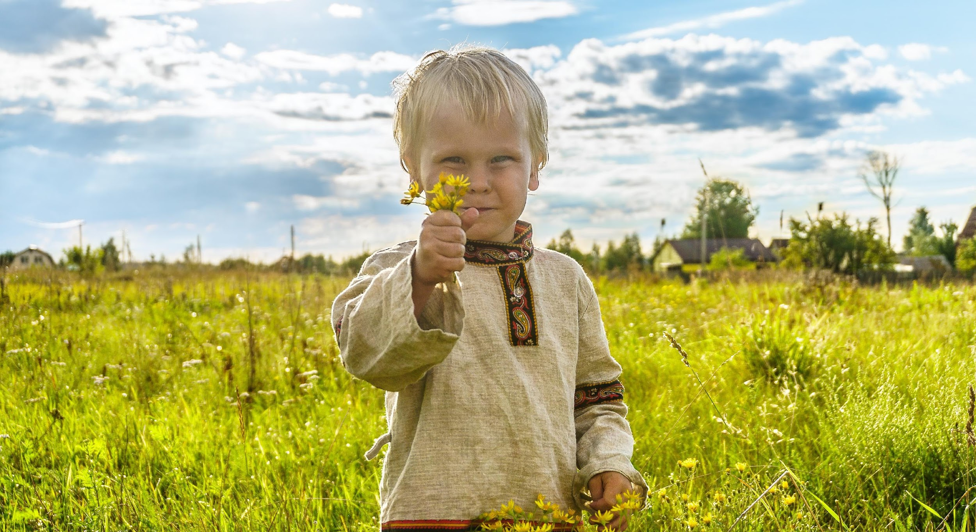
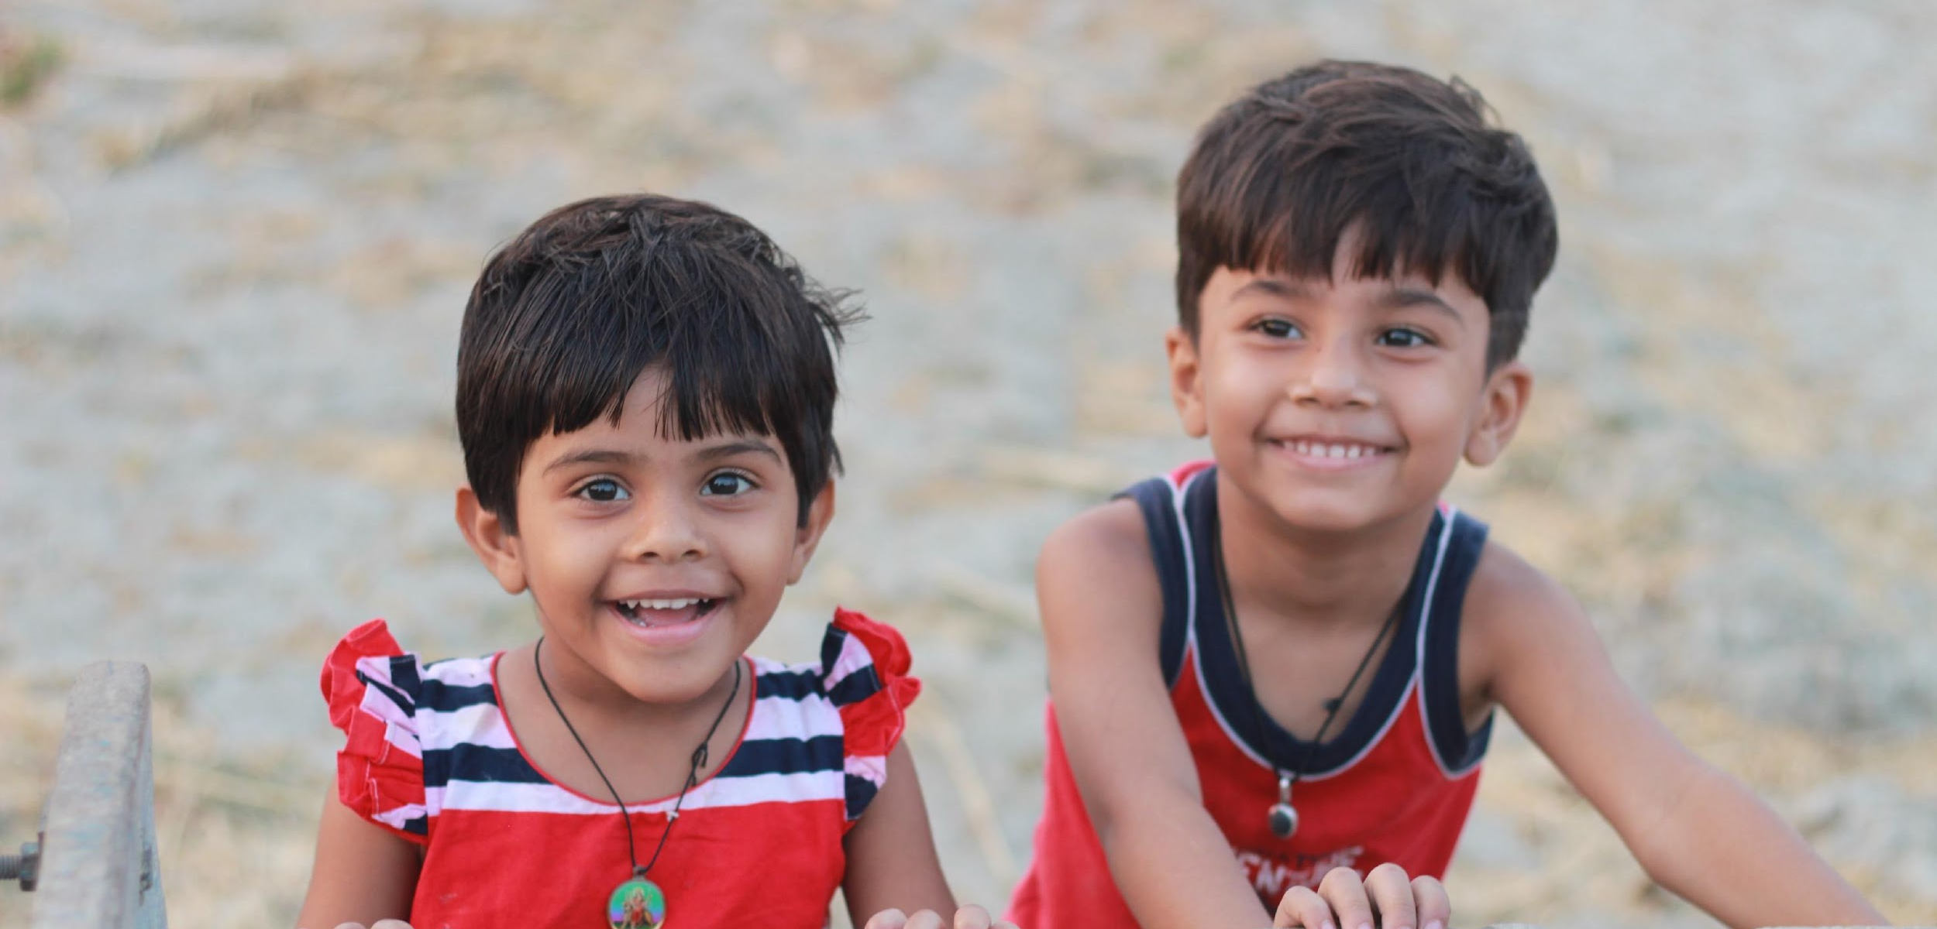

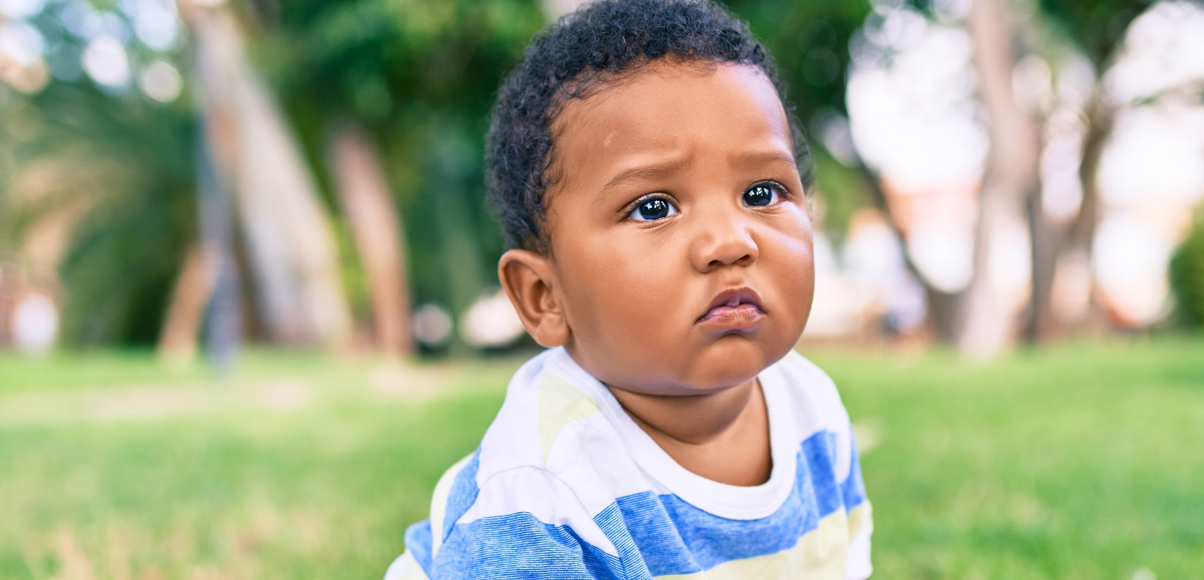

Slide 8
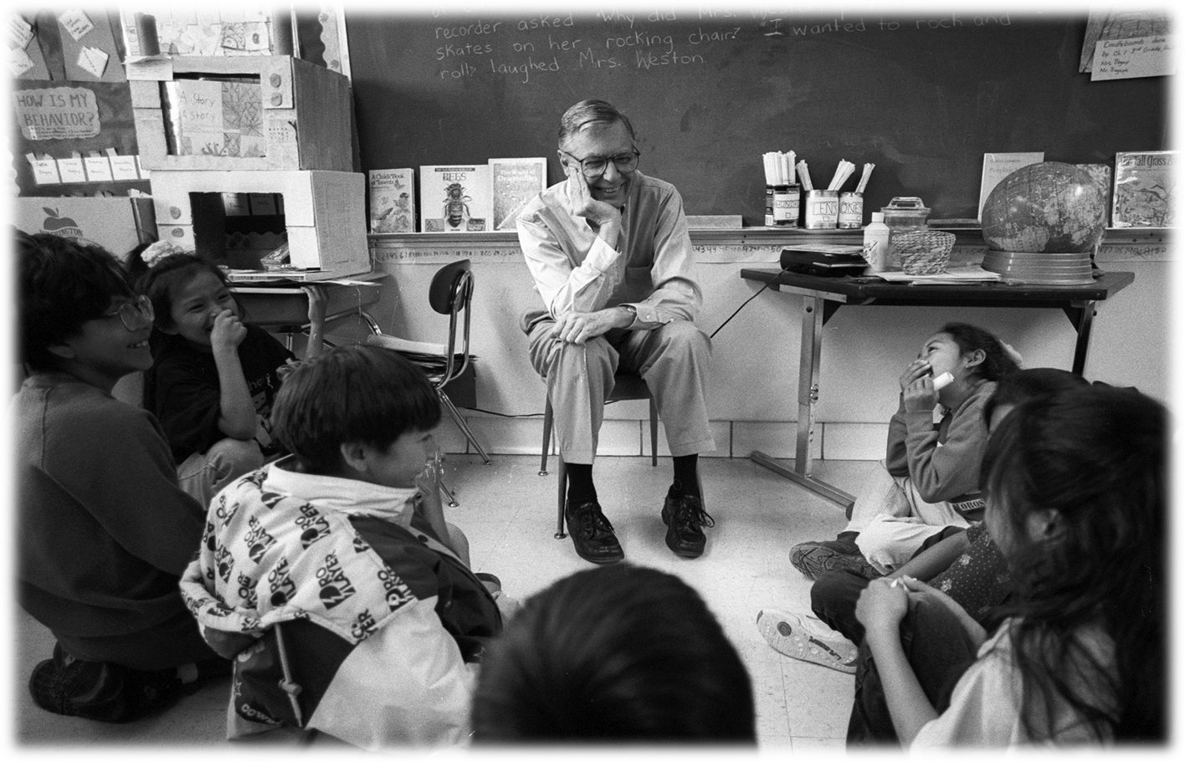
It’s through
relationships
that we grow
best—and learn
best.
Fred Rogers

Slide 9
Social and Emotional Wellbeing
Children can…
Form close, secure, meaningful relationships
Experience, regulate, and express emotions
Explore the environment and learn new skills

Slide 10

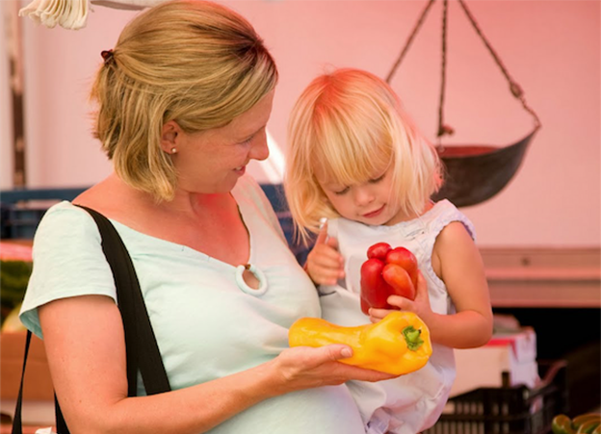
Serve and Return Interactions
Photo credit to developingchild.harvard.edu

Slide 11
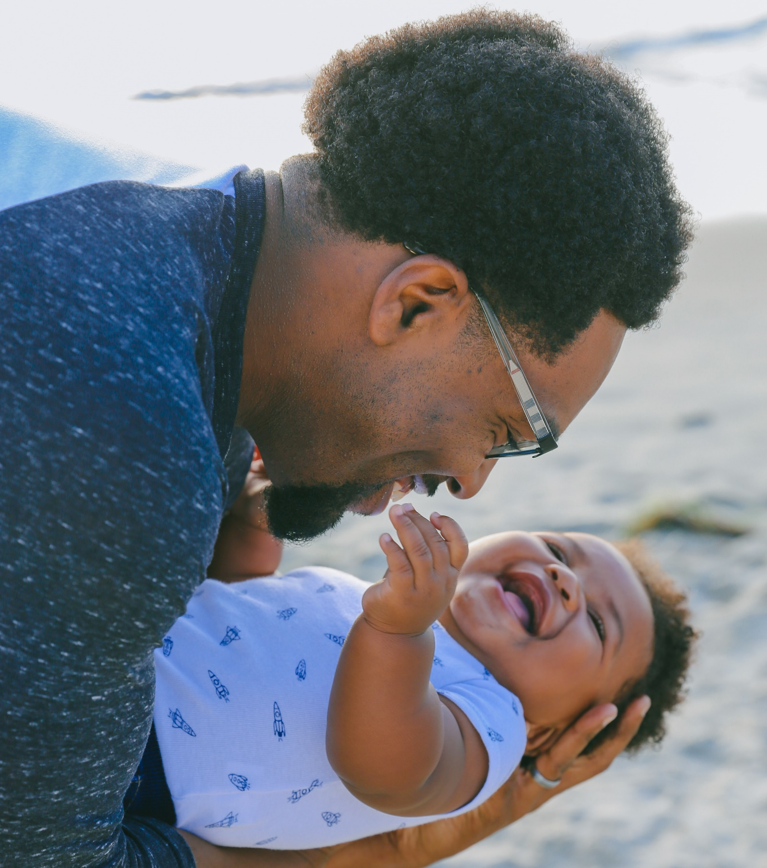
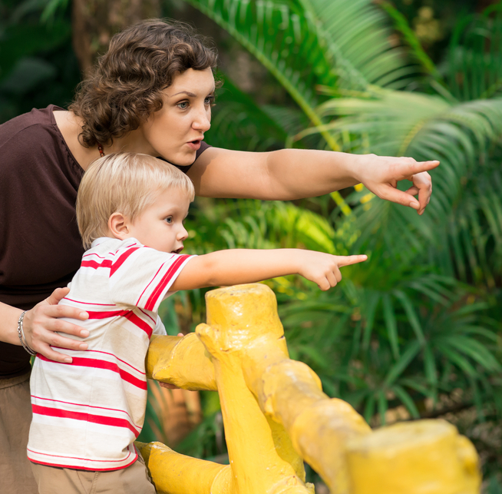
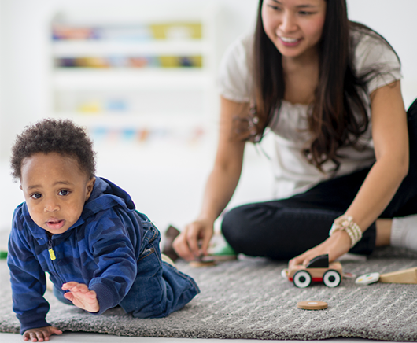
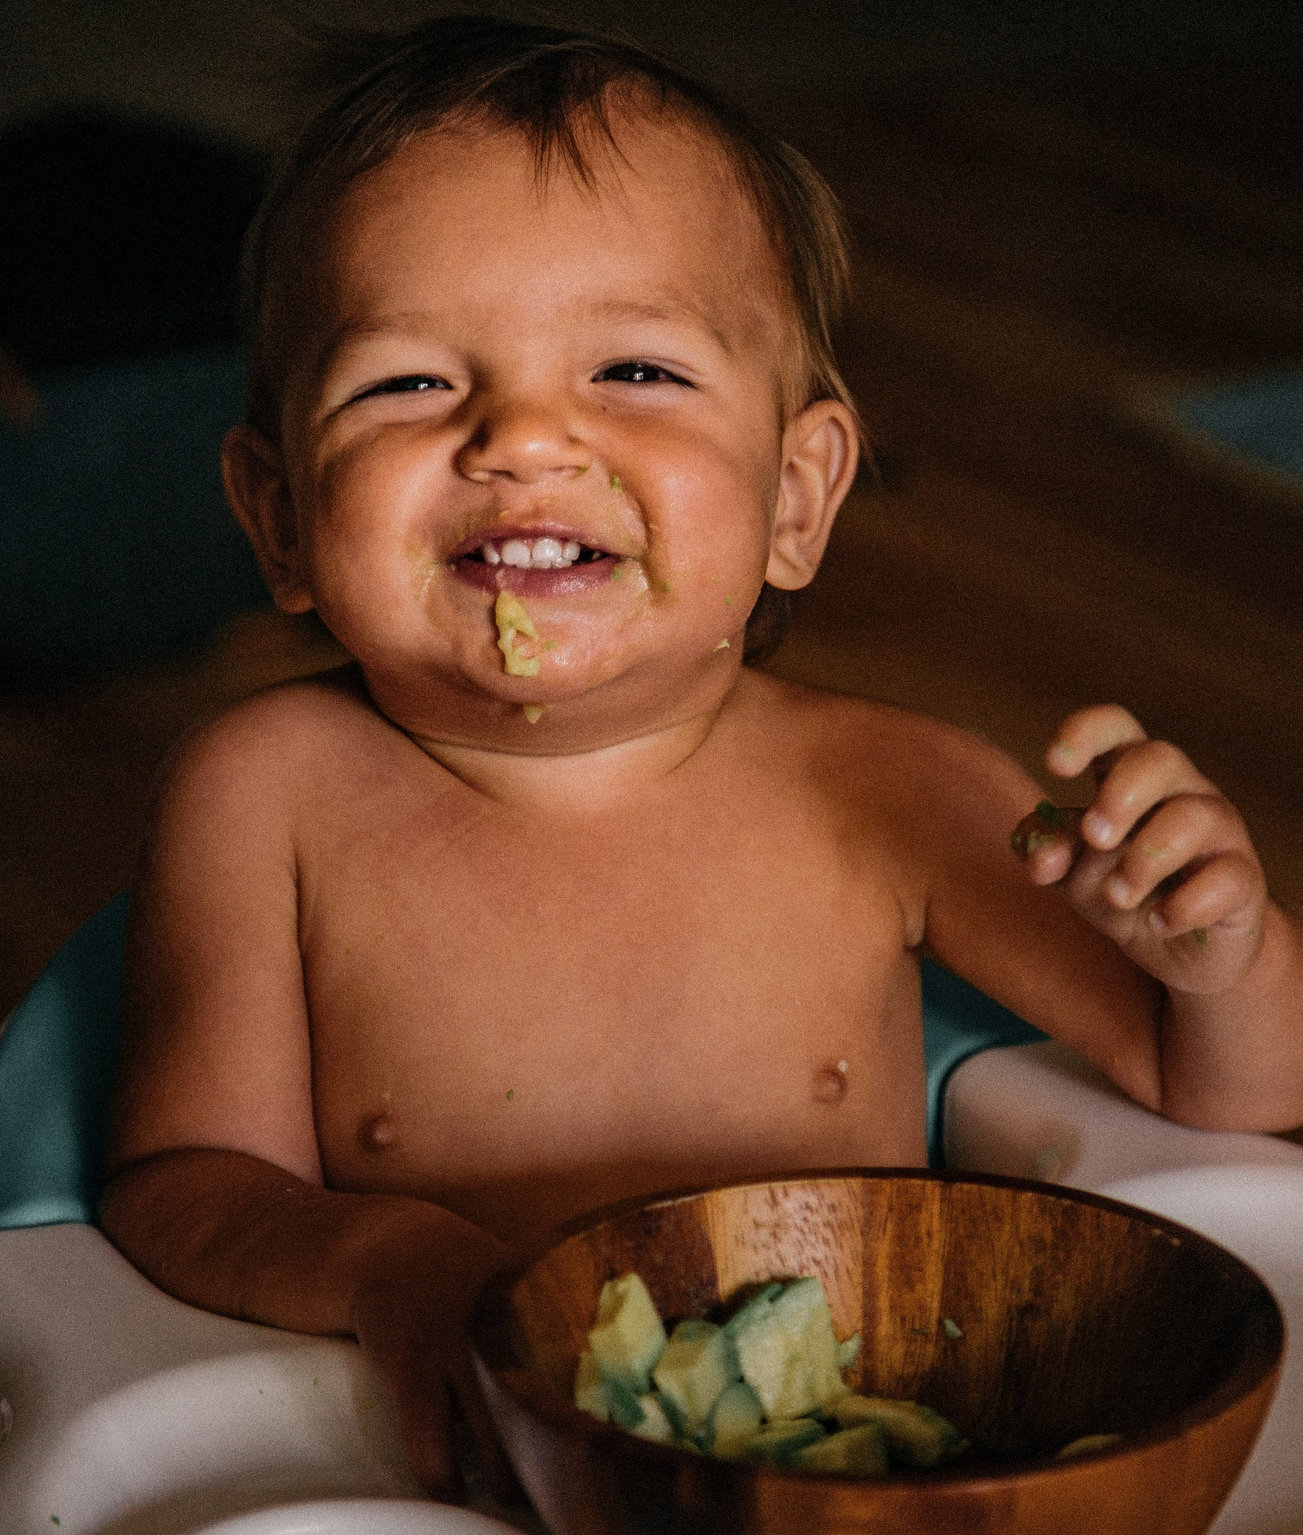
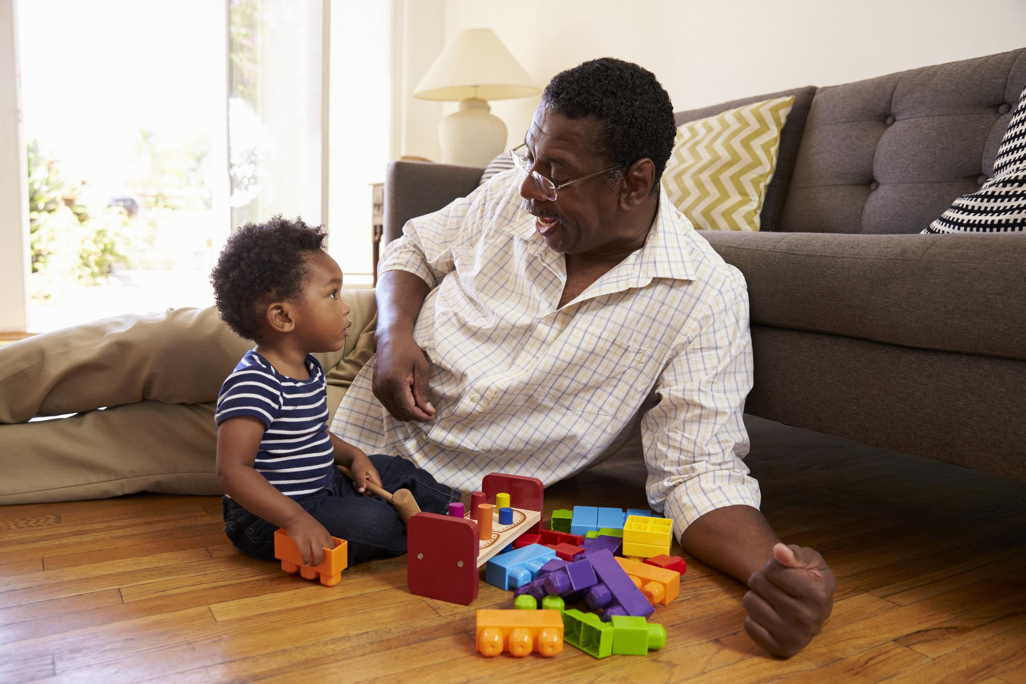
Serve and Return Interactions
Sharing attention
Supporting and encouraging
Putting words to it
Taking turns...and waiting
Practicing endings & beginnings
Photo credit to developingchild.harvard.edu
Notes:
Paste into Chat: Learn more about Trying Together: tryingtogether.org

Slide 12
Serve and return forms the foundation of brain architecture upon which all future development will be built.
Harvard Center on the Developing Child
Notes:
Please create a copy of this powerpoint or slide to edit. Please add your email here. You can copy it from the notes to enter it in the chat box.

Slide 13
Building Social-Emotional Skills: Storytime
Ask your child…
What do you think will happen next?
How do you think this character is feeling? How can you tell?
What did you notice about the character?
What would you do if you were in this situation?
How do you think you might feel if you were in this situation?

Slide 14
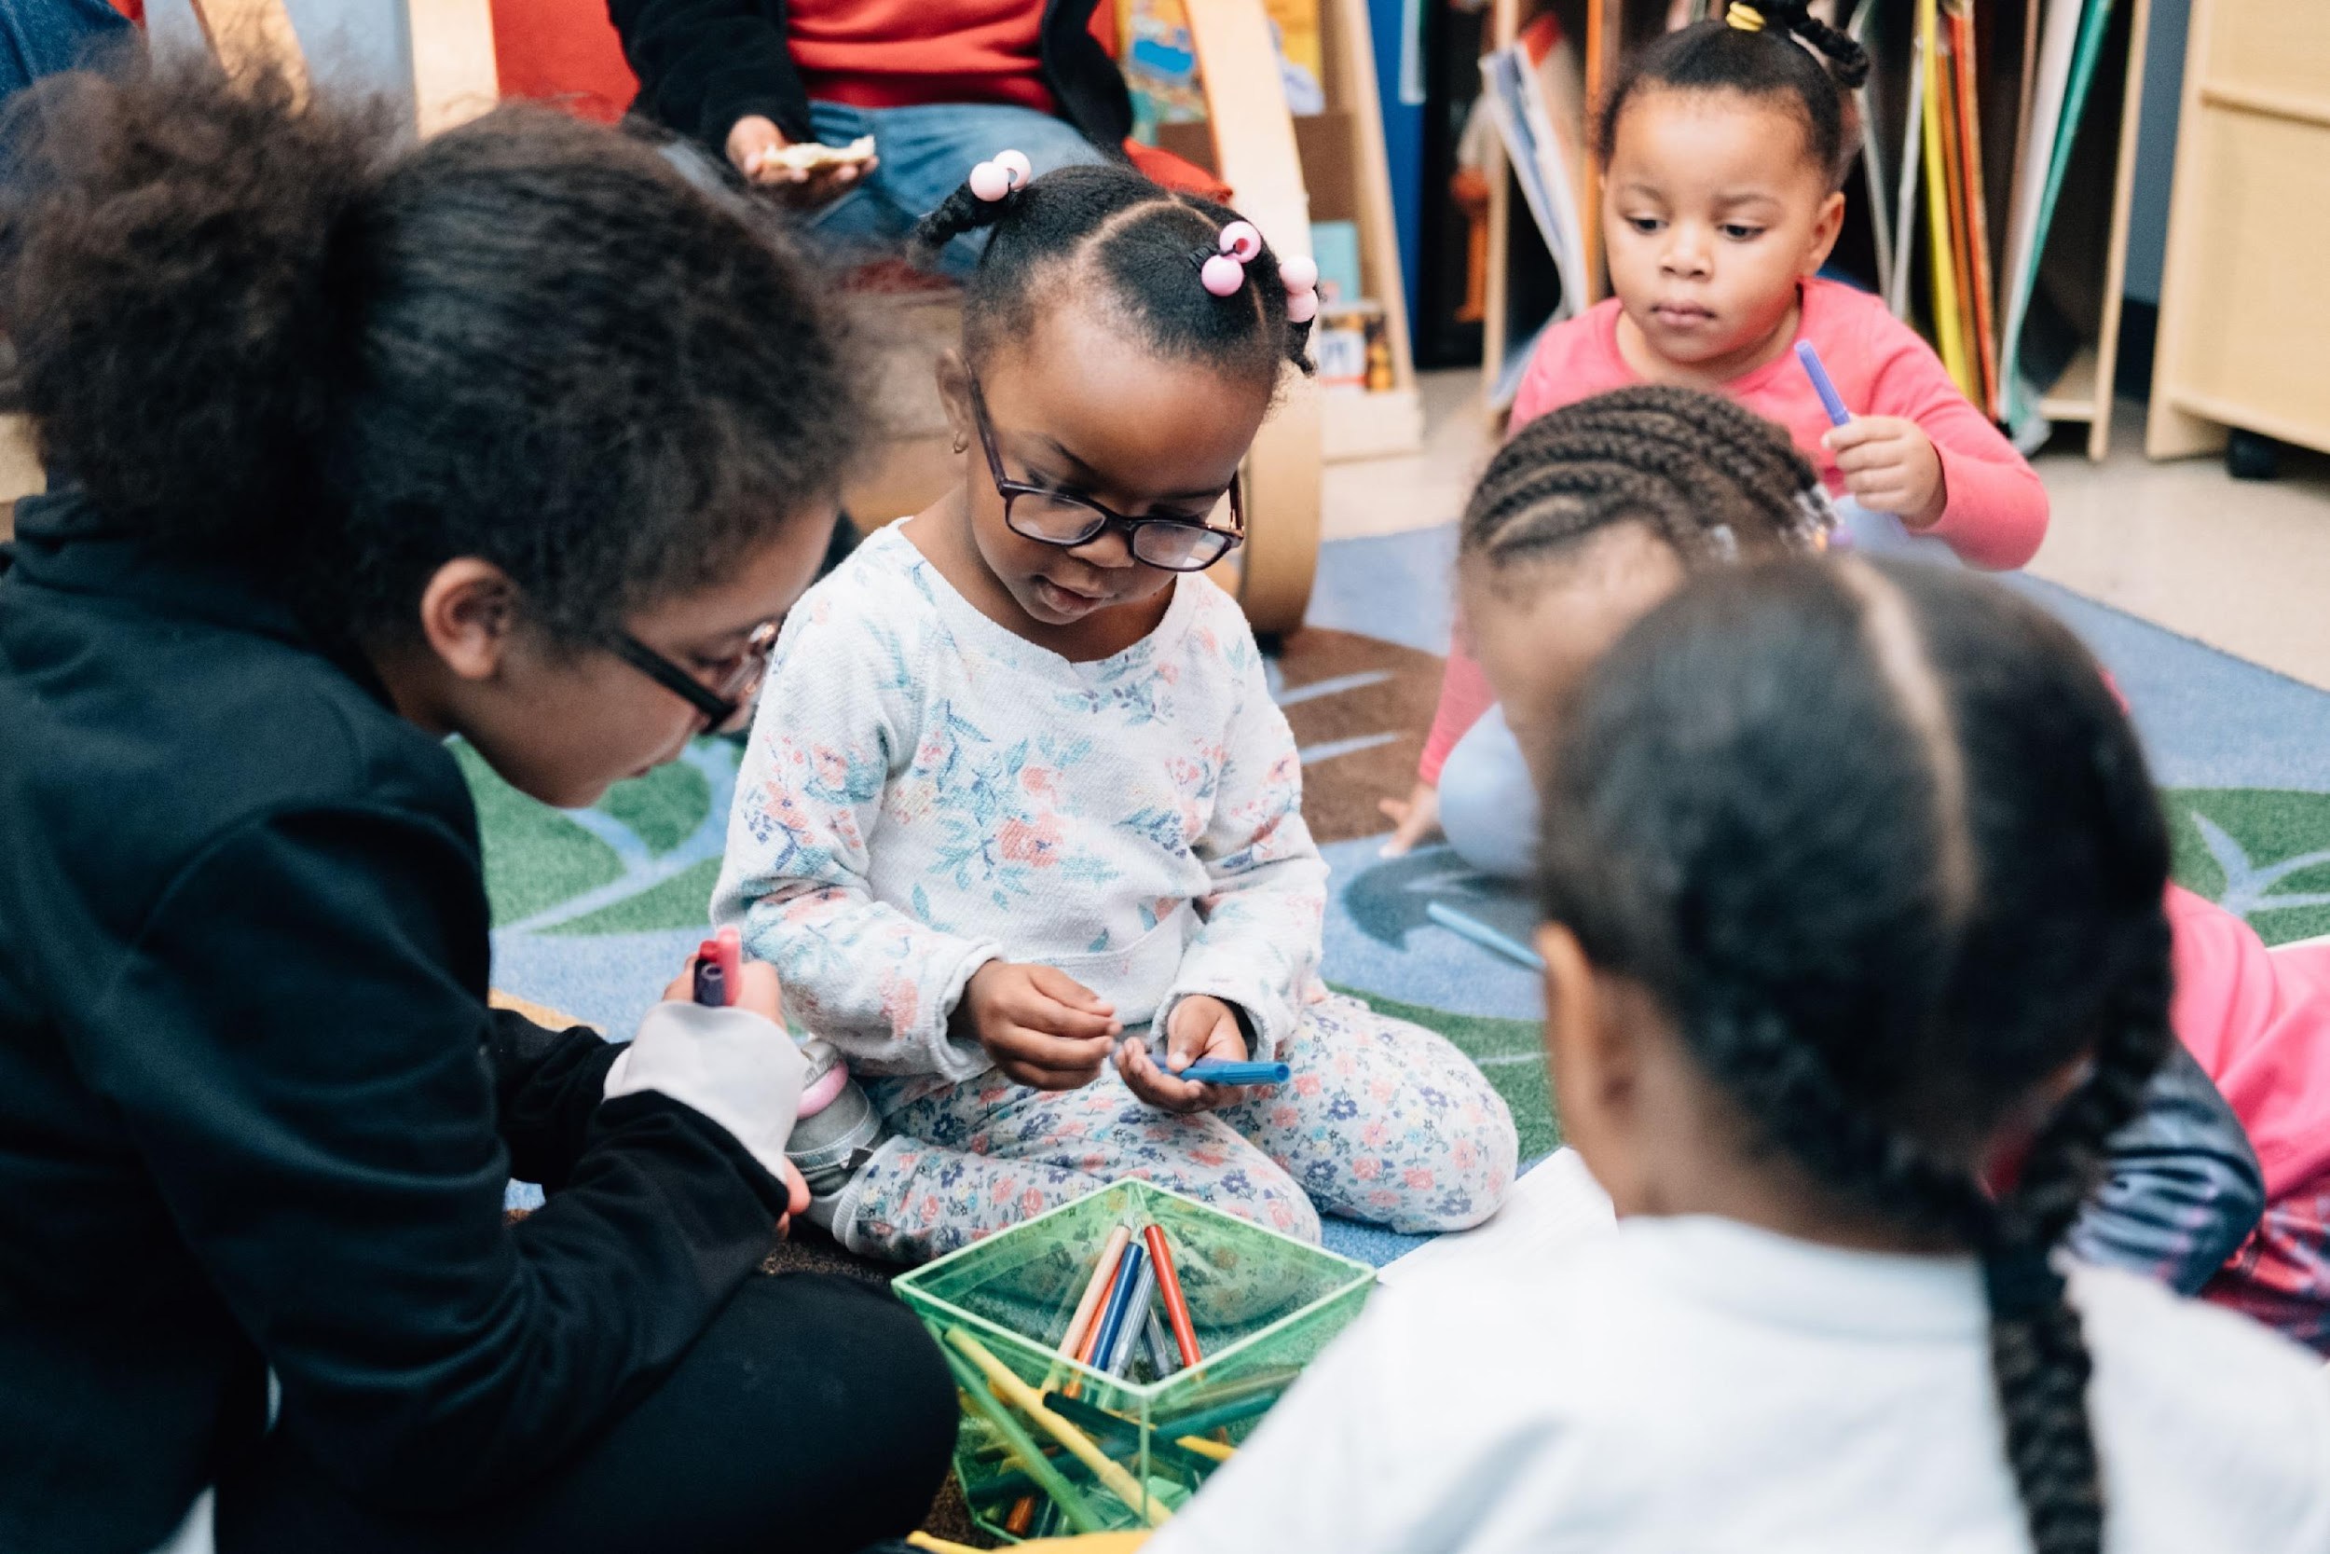
Building Social-Emotional Skills: Play
Puppets and stories
Artistic expression
Scientific inquiry
Dramatic play

Slide 15
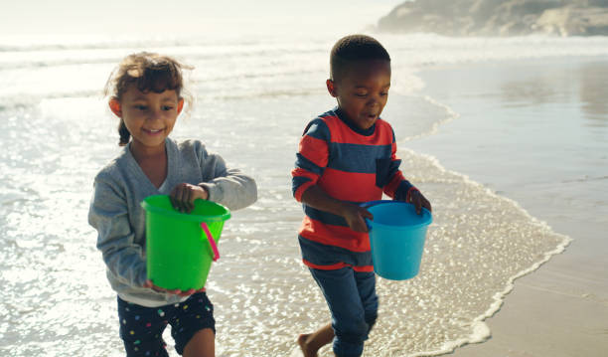
Building Social-Emotional Skills: Choices & Boundaries
Cultivating alone space
Respecting boundaries
Asking for consent
Notes:
Paste into Chat: Learn more about Trying Together: tryingtogether.org

Slide 16
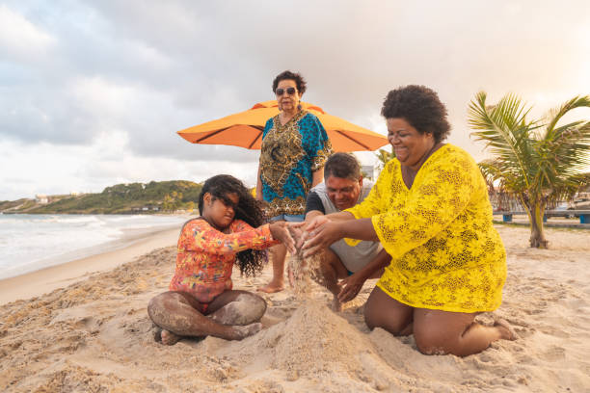
Building Social-Emotional Skills: Sense of Belonging

Slide 17
Join Our Campaigns
Start Strong PA
Advocate for affordable high-quality child care: startstrongpa.org
Pre-K for PA
Advocate for increased access to high-quality pre-k: prekforpa.org
Childhood Begins at Home
Advocate for evidence-based home visiting: childhoodbeginsathome.org
Support Our Public Policy Agenda
Receive advocacy alerts right in your inbox: bit.ly/advocacy-alert
Notes:
Please create a copy of this powerpoint or slide to edit. Do not include this slide for events hosted by ELRC Region 5.

Slide 18
More Resources from Trying Together
Allegheny Child Care - www.alleghenychildcare.org
Early Learning Resource Center Region 5 - elrc5.alleghenycounty.us
The Homewood Early Learning Hub & Family Center - www.tryingtogether.org/community-resources/hub-and-family-center
Developmentally Appropriate Parenting (DAP) Series - https://tryingtogether.org/parenting-resources/
Notes:
Cristina and Lindsey

Slide 19

Notes:
This slide should be included at the end of every PowerPoint.

Slide 20
Contact Information
Sarah Grubb
Everyday Interactions Design Strategist
Trying Together
ELRC Region 5
Sarah.elrc5@alleghenycounty.us
Notes:
Please create a copy of this powerpoint or slide to edit. Please add your email here. You can copy it from the notes to enter it in the chat box.

Slide 21
Resources
Trying Together Developmentally Appropriate Parenting Series, Social-Emotional Development: https://tryingtogether.org/dap/part-six/
Trying Together, Respecting Your Child’s Boundaries: https://tryingtogether.org/dap/children-boundaries/
Zero to Three, Social-Emotional Development: https://www.zerotothree.org/resources/238-birth-to-12-months-social-emotional-development
Center on the Developing Child, Harvard University, Serve and Return:
https://developingchild.harvard.edu/science/key-concepts/serve-and-return/
The Kaleidoscope Project, Social-Emotional Wellbeing: https://www.kaleidoscopewake.org/social-emotional-well-being
Doing Good Together, Picture Books that Nurture Emotional Awareness, https://www.doinggoodtogether.org/bhf-book-lists/emotional-awareness-picture-books
Trying Together, Art Activities that Encourage Social-Emotional Development,
https://tryingtogether.org/dap/social-emotional-art/
Notes:
Please create a copy of this powerpoint or slide to edit. Please add your email here. You can copy it from the notes to enter it in the chat box.

